Slide 1
CompTIA A+ Guide to IT Technical Support
10th Edition

Slide 2

Windows Versions and Customer Service
Chapter 11

Slide 3
Objectives
Use Windows to interface with users, files and folders, applications, and hardware
Use Windows tools to examine and support the system
Explain the various ways Windows secures resources on the network and secures a network connection
Support customers with professionalism and respect, in addition to your technical skills

Slide 4
Windows Interfaces
An operating system (OS) is software that controls a computer
All OSs share the following four main functions:
Provide a user interface
Manage files
Manage hardware
Manage applications
Windows 10 is the latest Microsoft OS and is an upgrade to Windows 8
Which was preceded by Windows 7
Every Windows OS offers a graphical user interface (GUI)
Uses graphics instead of a command-driven interface
Windows 10 offers two GUIs: the desktop and Tablet mode via a feature called Continuum

Slide 5
Windows 10 Interface (1 of 7)
Windows 10 Desktop
Tools used by technicians to support, secure, and troubleshoot Windows, as well as productivity software, can be accessed from the Start menu, desktop, and taskbar
Taskbar:
Usually located at the bottom of the Windows desktop
Displays information about open programs and provides quick access to others
By default, Windows 10 pins the Task View, Microsoft Edge, File Explorer, and Store icons in the Quick Launch toolbar on the left side of the taskbar
The Start Menu has live tiles on the right side of the menu that offer continuous real-time updates
The bottom-left corner of the Start menu has a few icons that you can use to access important functions

Slide 6
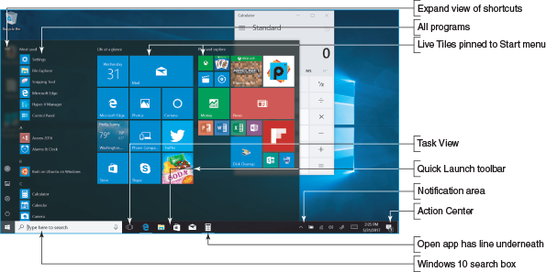
Windows 10 Interface (2 of 7)
Figure 11-2 Windows 10 uses a Start menu with live tiles

Slide 7
Windows 10 Interface (3 of 7)
Windows 10 Desktop (continued):
To launch a program from the desktop, use one of these methods:
Start menu
Windows 10 search box with Cortana
Quick Launch menu
Pin to taskbar
Double-click the program file name in File Explorer
Shortcut on the desktop
Run box or search box

Slide 8
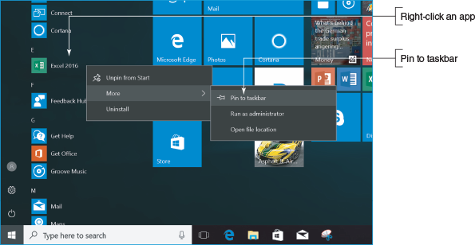
Windows 10 Interface (4 of 7)
Figure 11-5 Right-click an app to pin it to the taskbar from the Start menu

Slide 9
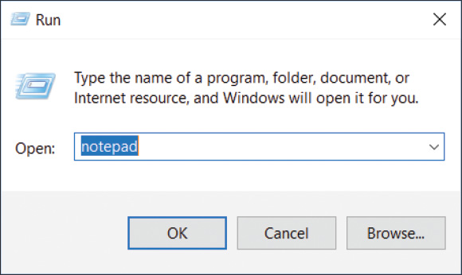
Windows 10 Interface (5 of 7)
Figure 11-7 Use the Run box to launch a program

Slide 10
Windows 10 Interface (6 of 7)
Windows 10 Features
Action Center – used to toggle several Windows features on and off, access the Settings app, and view notifications
Cortana – Windows 10’s digital assistant that can learn your speech, handwriting patterns, and typing history to assist with user input
Snap Assist – used to snap windows to an edge or corner and allows for half and quadrant snapping
Task View – used to create multiple virtual desktops so you can flip through to the desired desktop as needed

Slide 11
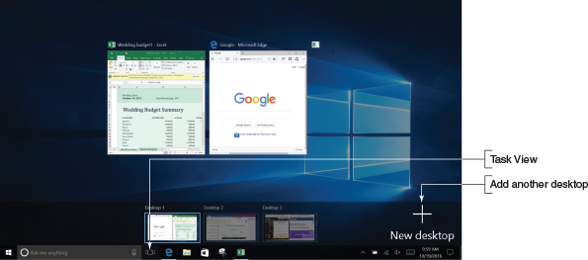
Windows 10 Interface (7 of 7)
Figure 11-10 Use Task View to organize your open apps

Slide 12
Choosing a Windows Edition (1 of 2)
Windows 10 editions for personal computers include Windows 10 Home, Windows 10 Pro, Windows 10 Enterprise, and Windows 10 Education
Windows 8 options are Windows 8.1 Core, Windows 8.1 Pro, and Windows 8.1 Enterprise
Windows 7 options are Windows 7 Home Basic and Premium, Windows 7 Professional, and Windows 7 Enterprise
Select Windows 10 if possible:
Microsoft support for its latest OS will last longer and Windows 10 is an improvement
When choosing an edition of Windows, consider the purposes for using Windows

Slide 13
Choosing a Windows Edition (2 of 2)
Consider the following features that the user or organization might require (not available in the Home edition):
Domain access
BitLocker
Encryption File System (EFS)
Branchcache
Media Center

Slide 14
Windows Tools for Users and Technicians
All users need to know how to use File Explorer or Windows Explorer
A technician also needs to know how to use:
Control Panel
Power Options
System window
System information Window
Action Center (for Windows 8/7)

Slide 15
Windows 10/8 File Explorer and Windows 7 Windows Explorer (1 of 16)
To Open File Explorer or Windows Explorer
Click the yellow File Explorer or Windows Explorer icon in the taskbar
From Windows 10/8 desktop:
Open the Quick Launch menu (press Win+X) and click File Explorer in the menu
For Windows 7:
Right-click Start and select Open Windows Explorer from the menu
For Windows 10:
Enter explorer in the search box
In Windows 10:
Click the microphone button in the search box and tell Cortana to “Open File Explorer”

Slide 16
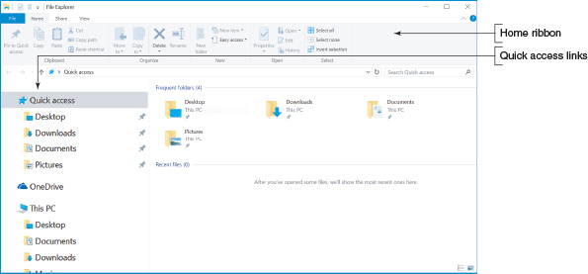
Windows 10/8 File Explorer and Windows 7 Windows Explorer (2 of 16)
Figure 11-19 The Windows 10 File Explorer window with the Home ribbon show

Slide 17
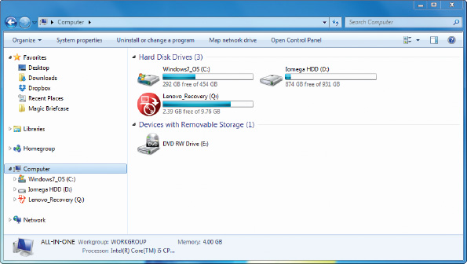
Windows 10/8 File Explorer and Windows 7 Windows Explorer (3 of 16)
Figure 11-20 The Windows 7 Windows Explorer window with the Computer item selected in the left pane

Slide 18
Windows 10/8 File Explorer and Windows 7 Windows Explorer (4 of 16)
Files and Directories
Every OS manages a hard drive, optical drive, USB drive, or other type of drive by using directories (also called folders), subdirectories, and files
The drive is organized with a single root directory
Located at the top of the top-down hierarchical structure of subdirectories
Exception: a hard drive
Divided into partitions
Each volume has its own root directory and hierarchical structure of subdirectories
The root directory can hold files or other directories
These directories are called subdirectories, child directories, or folders
Any directory can have files and other subdirectories in it

Slide 19
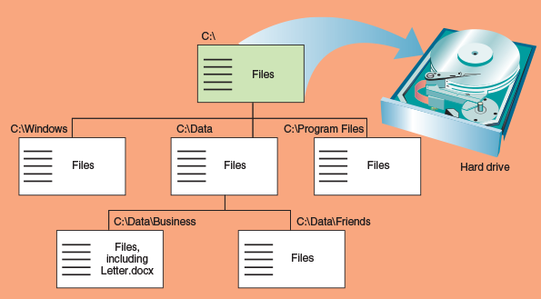
Windows 10/8 File Explorer and Windows 7 Windows Explorer (5 of 16)
Figure 11-21 Storage devices such as a USB drive, DVD, or hard drive are organized into directories and subdirectories that contain files

Slide 20
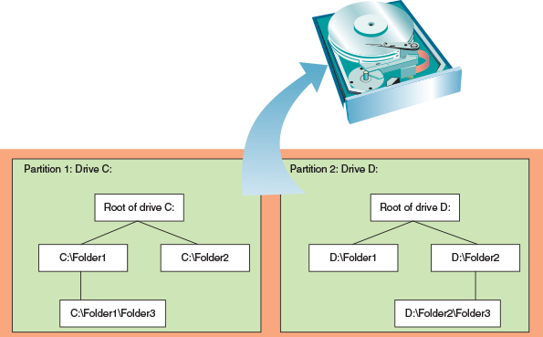
Windows 10/8 File Explorer and Windows 7 Windows Explorer (6 of 16)
Figure 11-22 A hard drive can be divided into one or more partitions that can each contain a volume such as drive C: or drive D:

Slide 21
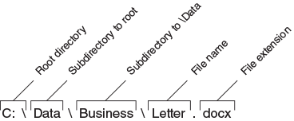
Windows 10/8 File Explorer and Windows 7 Windows Explorer (7 of 16)
Figure 11-23 The complete path to a file includes the volume letter, directories, file name, and file extension; the colon, backslashes, and period are required to separate items in the path

Slide 22
Windows 10/8 File Explorer and Windows 7 Windows Explorer (8 of 16)
Navigate the Folder Structure
Tips to navigate when working with File Explorer or Windows Explorer
Click or double-click items in the left pane (called navigation pane) to drill down to subfolders
To control how files appear in the right pane in Windows 10/8, click one of the icons in the lower-right corner to select Thumbnail view or Details view
For Windows 7, click the View icon and select your view
To control column headings that appear in the Details view, right-click a column heading and select the headings that you want to appear

Slide 23
Windows 10/8 File Explorer and Windows 7 Windows Explorer (9 of 16)
Navigate the Folder Structure (continued)
Tips to navigate when working with File Explorer or Windows Explorer (continued)
Use the Search box in the upper-right corner of the window
Use the forward and back arrows in upper-left corner to move forward and backward to previous views
Click a right arrow in the path displayed in the address bar at the top of the Explorer widows to see a drop-down list of subfolder

Slide 24
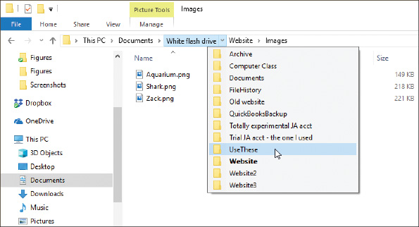
Windows 10/8 File Explorer and Windows 7 Windows Explorer (10 of 16)
Figure 11-26 Click a right arrow in the address bar to move up the folder tree and down to a new folder

Slide 25
Windows 10/8 File Explorer and Windows 7 Windows Explorer (11 of 16)
Create a Folder
Select the parent folder
Use one of these methods to create a folder:
In Windows 10/8, select the Home ribbon and click New folder
In Windows 7, click New folder on the menu bar
Right-click in the white area of the right pane
Select New from the shortcut menu
Click Folder to create a regular folder or click Compressed Folder to create a compressed folder
Folder is created and highlighted so that it may be renamed

Slide 26
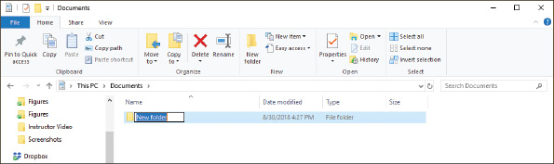
Windows 10/8 File Explorer and Windows 7 Windows Explorer (12 of 16)
Figure 11-28 Edit the new folder’s name

Slide 27
Windows 10/8 File Explorer and Windows 7 Windows Explorer (13 of 16)
Create a File
Use a particular application
Use File Explorer or Windows Explorer
Right-click in the unused white area in the right pane of the window and point to New
Click the application you want to use in order to create a file
You can rename the filename (keep the file extension the same)

Slide 28
Windows 10/8 File Explorer and Windows 7 Windows Explorer (14 of 16)
Copy, Move, Rename, or Delete Files or Folders
To copy a file or folder, right-click file, select Copy from the shortcut menu
Right-click in folder white area where the copied item goes
Select Paste from the shortcut menu
Drag and drop item to its new location (move)
To copy, hold down the Ctrl key while you drag and drop
To rename a file or folder, right-click it and select Rename from the shortcut menu
To delete a file or folder, select the item and press the Delete key
Can also right-click on the item and select Delete from the shortcut menu
To select multiple items to delete, copy, or move at the same time, hold down the Shift or Ctrl key as you click
Shift key selects adjacent items in a list
Ctrl key selects nonadjacent items in a list

Slide 29
Windows 10/8 File Explorer and Windows 7 Windows Explorer (15 of 16)
Create a Shortcut
Use File Explorer or Windows Explorer to locate the data file or program file
Right-click, click Create shortcut in the menu

Slide 30
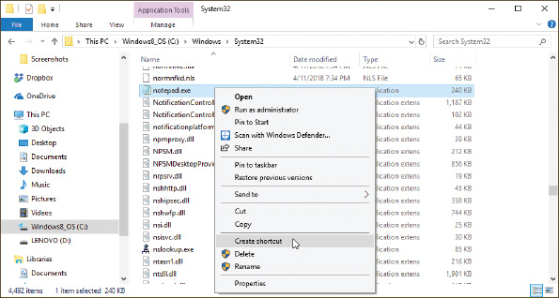
Windows 10/8 File Explorer and Windows 7 Windows Explorer (16 of 16)
Figure 11-29 Place a shortcut to a program file on the Windows desktop

Slide 31
Control Panel (1 of 2)
Control Panel is a window containing applets used to manage hardware, software, users, and the system
To access Control Panel in Windows 10, type Control Panel in the search box on taskbar
Accessing Control Panel in Windows 8:
Right-click Start (click Start in Windows 7) and the click Control Panel
By default, Control Panel appears in Category view
Utilities are grouped by category
Switch to classic view by clicking Category and select either Large icons or Small icons

Slide 32
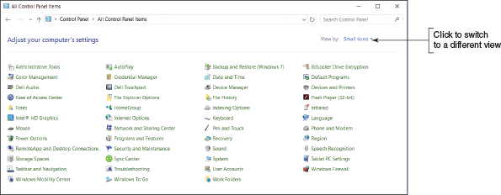
Control Panel (2 of 2)
Figure 11-30 Many technicians prefer to use Control Panel in Classic view to more easily access utilities

Slide 33
Windows 10 File Explorer Options or Windows 8/7 Folder Options
Windows 10 File Explorer Options applet or the Windows 8/7 Folder Options applet in Control Panel can be used to view and change options assigned to folders
Controls how users view files in a folder, what users can do with the files
File extensions:
Used to identify file types
Windows does not show file extensions if it knows which application is associated with a file extension
Windows hides system files until you force it to show them

Slide 34
Power Options
The Power Options applet of Control Panel can help you conserve power and increase the time before a battery pack on a laptop needs recharging
Different power-saving states:
Sleep mode (also called standby mode or suspend mode) – Windows saves current state including open files to memory
Everything is shut down except memory and enough of the system to respond to a wake-up
Windows can still perform Windows updates and scheduled tasks
Windows can be configured to go to sleep after a period of inactivity, or you can manually put it to sleep
Hibernation – saves all work to the hard drive and powers down the system

Slide 35
System Window (1 of 2)
The System window can give you a quick look at what hardware and software is installed
To open in Windows 10:
Open Control Panel and click System
To open the System window in Windows 8:
Open the Quick Launch menu (press Win+X)
Click System
In Windows 7:
Click Start
Right-click Computer
Select Properties

Slide 36
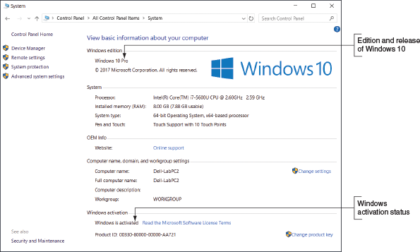
System Window (2 of 2)
Figure 11-35 The System window reports Windows 10 Pro is installed

Slide 37
System Information Window (1 of 2)
The System Information window is used to view detailed information about the system
Important information to view:
BIOS/UEFI version installed
How much RAM is installed
OS installation directory
Hard drive size
Names of currently running drivers
Device drivers: small programs stored on hard drive that tell the computer how to communicate with a specific hardware device
List of startup programs
Print jobs in progress and currently running tasks

Slide 38
System Information Window (2 of 2)
To run System Information in Windows 10:
Enter msinfo32 in the search box
For Windows 8:
Open the Quick Launch menu
Click Run
Enter msinfo32.exe in the Run box and press Enter
For Windows 7:
Click Start
Enter Msinfo32.exe in the Search box and press Enter

Slide 39
Windows 10 Settings App (1 of 2)
The Windows 10 Settings app is a user-friendly interface to access Windows settings
Open the app from the Start menu, the Quick Launch menu, or by pressing Win+I
The primary menu includes settings for the following:
System
Devices
Network & Internet
Personalization
Apps
Accounts
Time
Gaming
Ease of Access, Privacy, and Update & security

Slide 40
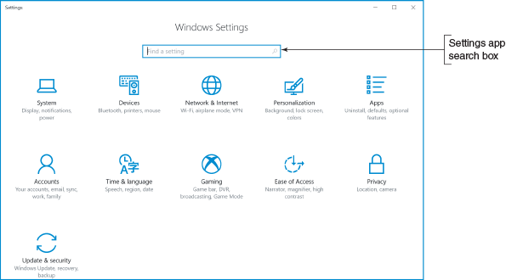
Windows 10 Settings App (2 of 2)
Figure 11-38 The new Windows 10 Settings app

Slide 41
How Windows Controls Access to Network Resources
If a network is public (public hotspot) resources are not shared
Private networks often share their resources
Windows offers three ways to share resources:
Workgroups
Homegroups
Domains

Slide 42
Windows Workgroup and Homegroup (1 of 2)
Peer-to-peer (P2P) network:
A network that doesn’t have centralized control
In a Windows workgroup:
Each computer maintains a list of users and their rights on that particular computer
In a homegroup:
Each computer shares files, folders, libraries, and printers with other computer in the homegroup
Provides less security than a workgroup

Slide 43
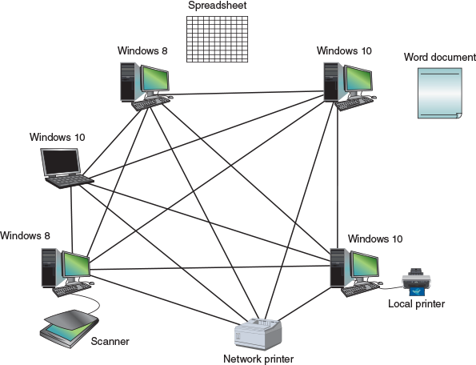
Windows Workgroup and Homegroup (2 of 2)
Figure 11-42 A Windows workgroup is a type of peer-to-peer network where no single computer controls the network and each computer controls its own resources

Slide 44
Windows Domain (1 of 3)
A Windows domain is implemented on a larger, private network:
Forms a logical group of networked computers that share a centralized directory database of user account information and security
A type of client/server network where resources are managed by centralized computers
The directory database is controlled by a network operating system (NOS)
Windows 10/8 allows three types of accounts to sign in to Windows: a local account, a Microsoft account, and a network ID
Windows 7 uses local accounts and network IDs but does not use Microsoft accounts

Slide 45
Windows Domain (2 of 3)
Microsoft offers two options for managing a domain:
Active Directory: Windows Server controls a network using this directory database
Azure Active Directory: manages users in the cloud and creates a virtual network of users connected through the Internet
Windows 10 offers three ways to authenticate a user:
Domain join
Azure AD join
Bring your own device (BYOD) experience

Slide 46
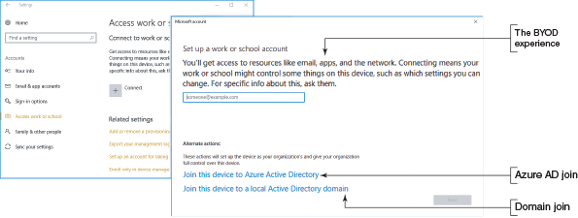
Windows Domain (3 of 3)
Figure 11-45 Three ways to join a domain

Slide 47
Domain Setup
To change the way Windows connects to the network:
You’ll need the network ID and password to the domain provided by the network administrator
Open the System window
Under Computer name, domain, and workgroup settings, click Change settings
In the System Properties box, click Network ID and follow the directions on the screen

Slide 48
Public and Private Networks
Windows 10/8 offers three types of network security:
Public network – Windows configures strong firewall settings and you cannot join a homegroup or domain
Private network – you can join a homegroup or domain and share files and printers
Domain network – the domain yields control for authenticating users and sharing files, folders, and printers to settings in Active Directory or Azure AD managing the domain
Windows 7 security options:
Public network – Network Discovery is turned off
Home network – Network Discovery is on and can join a homegroup
Work network – Network Discovery is on and you can join a domain, but not a homegroup
Domain network - the domain yields control for authenticating users and sharing files, folders, and printers to settings in Active Directory

Slide 49
What Customers Want: Beyond the Technical Know-How
An IT support technician should commit to providing excellent service and to treating customers as you would want to be treated in a similar situation
It is important to be prepared:
Includes knowing what customers want, what they don’t like, and what they expect from an IT technician

Slide 50
Becoming a Competent and Helpful Support Technician
Traits of a competent and helpful technician:
Be dependable and reliable
Keep a positive and helpful attitude
Listening without interrupting your customer
Use proper and polite language
Show sensitivity to cultural differences
Express patience and honor to those with physical disabilities
Take ownership of the problem
Portray credibility
Work with integrity and honesty
Know the law with respect to your work
Dress and behave professionally

Slide 51
Planning for Good Service (1 of 8)
Key to success: Don’t allow circumstances or personalities to affect your commitment to excellence
Most good service for customers of IT support begins with entries in call tracking software
Call Tracking Software
Call tracking software tracks support calls and gives technicians a place to keep their call notes
Initial call for help starts the process by creating a ticket
Ticket is a record of the request and what is happening to resolve it
Stays open until the issue is resolved
Support staff assigned to the ticket document progress in the call tracking system
As an open ticket ages, more attention and resources are assigned to it

Slide 52
Planning for Good Service (2 of 8)
Initial Contact with a Customer
Customers expect both technical and interpersonal skills
Beginning a phone call professionally
Identify yourself and your organization
Ask for and write down name and number of caller
Follow company polices to obtain further information
Be familiar with your company’s customer service policies
Open up the conversation for the caller to describe the problem

Slide 53
Planning for Good Service (3 of 8)
Initial Contact with a Customer (continued)
Technicians should be prepared to:
Know:
The problem to be addressed
The urgency of the situation
What computer, software, and hardware need servicing
Arrive with a complete set of equipment needed
Greet customer in a friendly manner and shake hands
Listen and ask questions

Slide 54
Planning for Good Service (4 of 8)
Interview the Customer
As you ask questions:
Take notes
Keep asking questions until you thoroughly understand the problems
Have customers reproduce the problem
Use diplomacy and good manners

Slide 55
Planning for Good Service (5 of 8)
Set and Meet Customer Expectations
It is important to create an expectation of certainty with customers
Establish a timeline with your customer for completion of a project
Keep customer informed of progress
Give the customer an opportunity to make decisions about repairs
Repair or replace?
Help them decide which is to their advantage

Slide 56
Planning for Good Service (6 of 8)
Work With a Customer On Site
Avoid distractions
Don’t accept personal calls on your cell phone
Or use social media
Answer calls from work, but keep call to a minimum
If you must excuse yourself, explain to the customer and return as soon as possible
When working at a user’s desk:
Be as unobtrusive as possible as you work
Protect customer’s confidential materials
Don’t take over the mouse or keyboard without permission
Ask permission to use the printer or other equipment
Don’t use the phone without permission

Slide 57
Planning for Good Service (7 of 8)
Work With a Customer On Site (continued):
When working at a user’s desk (continued):
Accept personal inconvenience to accommodate the user’s urgent business needs
If user is present, ask before making a software or hardware change
Don’t disclose information on social media
Your goals can include educating the user as well as repairing the computer
Explain how to fix the problem and walk them through the process if necessary

Slide 58
Planning for Good Service (8 of 8)
Work With a Customer on the Phone
Requires more interaction with customers
Technicians must be able to visualize what the customer sees
Patience is required if dealing with a novice user
If call is disconnected, call back immediately
Don’t eat or drink while on the phone
If caller must be put on hold, tell them how long it will be before you get back to them
Speak clearly and slowly
Don’t complain about your job
Keep small talk upbeat and positive

Slide 59
Deal With Difficult Customers (1 of 3)
When The Customer is Not Knowledgeable:
Be specific with your instructions
Don’t ask the customer to do something that might destroy settings or files without having them back up first
Ask customer what is displayed on the screen to help track keystrokes
Follow along at your own computer
Give the customer plenty of opportunity to ask questions
Compliment the customer whenever you can
If customer cannot help you solve the problem without a lot of coaching, tactfully request that the caller have someone with more experience call you

Slide 60
Deal With Difficult Customers (2 of 3)
When The Customer is Overly Confident:
Compliment the customer’s knowledge, experience, or insight
Slow the conversation down
Don’t back off from using problem solving skills
Be careful not to accuse the customer of making a mistake
Even though the customer might be using technical jargon, do not use jargon back to the customer

Slide 61
Deal With Difficult Customers (3 of 3)
When The Customer Complains:
Be an active listener, and let customers know they are not being ignored
Give the customer a little time to vent, and apologize when you can
Don’t be defensive
Know how your employer wants you to handle a situation where you were verbally abused
If the customer is complaining about a product or service that is not from you company, don’t say “That’s not our problem”
If the complaint is against you or your product, identify the underlying problem if you can
Sometimes simply making progress or reducing the problem to a manageable state reduces the customer’s anxiety
Point out ways you think communication could be improved

Slide 62
The Customer Decides When the Work Is Done
When you think a problem is solved, allow the customer to decide when the service is finished
Complete these tasks before closing the call:
Reboot computer to make sure you have not caused a problem with the boot
Allow the customer enough time to be fully satisfied that all is working
Ask user to verify any restored data
Review service call with the customer
Explain preventative maintenance to the customer

Slide 63
Sometime You Must Escalate A Problem
Every technician does not know how to solve every problem with a computer
Sometimes, a problem needs to be assigned to someone higher in the support chain
If that happens, follow through to make sure the customer and new support person have made contact

Slide 64
Work With CoWorkers
Learn to be a professional when working with coworkers
Put business matters above personal matters
Do not be personally offended when someone lets you down or does not please you
Keep negative opinions to yourself
When a coworker starts to gossip, try to politely change the subject
Know your limitations and be willing to admit when you can’t do something

Slide 65
Chapter Summary (1 of 3)
An OS manages hardware, runs applications, provides an interface for users, and stores, retrieves, and manipulates files
Windows 10 offers two GUI: the desktop and Tablet mode
Ways to launch a program from the Windows 10 desktop include using the Start menu, the search box, the Quick Launch menu, an icon pinned to the taskbar, File Explorer, a shortcut on the desktop, and the Run option on the Quick Launch menu
Windows 10/8 File Explorer and Windows 7 Windows Explorer are used to manage files and folders on storage devices
The file extension indicates how file contents are organized and formatted and what program uses the file
Control Panel gives access to a group of utility programs used to manage the system

Slide 66
Chapter Summary (2 of 3)
The Windows 10 File Explorer Options and Windows 8/7 Folder Options applets in Control Panel change the way files and folders are displayed in Explorer
The System window gives a quick overview of the system, including which edition and version of Windows is installed and the amount of memory installed
The System Information window gives much more information about the computer than the System window, including information on hardware, device drivers, the OS, and applications
The Settings app is a centralized location for users to access common Windows 10 settings
Windows 10/8/7 supports workgroups and domains to manage resources on a private network
Windows 10/8 supports public and private settings to secure a network connection
Use the Settings app to set up a computer to connect to a workgroup or to authenticate a user so that the computer can join a domain

Slide 67
Chapter Summary (3 of 3)
Use the Network and Sharing Center to change the security settings for a Windows network connection
Customers expect their first contact with you to be professional and friendly, and expect that listening to their problem or request will be your first priority
Know how to ask penetrating questions when interviewing a customer about a problem
Set and meet customer expectations by using good communication about what you are doing or intending to do and allowing the customer to make decisions where appropriate
Deal confidently and gracefully with customers who are difficult, including those who are not knowledgeable, are overly confident, or complain
When you first start a new job, find out how to escalate a problem you cannot solve

